Slide 1
Delaware County Commonwealth of Pennsylvania
Election Violations, Fraud Cases
Leah Hoopes & Gregory Stenstrom
20 February 2023

Slide 2
Election Overview 2020 and 2022
Return Sheets were Fabricated across the County.
Chain of Custody was missing across the County.
Vote in Delaware County should not have been certified in 2020 and 2022
Votes are Forensically Impossible to Verify or Validate
They substitute Fake ballots for Real ballots

Slide 3
Violations and Surface Area for Fraud
So many election violations, and frenetic actions to manipulate the vote that NOTHING added up
It was “Chaos” according to correspondence between election officials
No Chain of Custody
L & A Testing not conducted iaw directives – surface area for fraud
Mail In Ballots sent to Registered votes who were not Verified
Return Sheets – which are the ground truth documents for certification were “reconstituted” and fabricated
The vote can NOT be Reconciled

Slide 4
Petition CV-2020-007523 Delaware County Court of Common Pleas - Status
Petition against Delaware County Board of Elections was filed by Stenstrom, Hoopes and Pruett 21Dec2020
Dismissed by Common Pleas Court of Delaware County
Commonwealth Court of PA ruled positively for Stenstrom and Hoopes in all but Judge had “judicial discretion” to dismiss
PA Supreme Court refused to hear it
SCOTUS docket 22-503 was considered 1/20
“DENIED” Monday 1/23
Request for Rehearing (Reconsideration) submitted 17Jan2023 (14 days)
SCOTUS will schedule new Conference 3-4 weeks

Slide 5
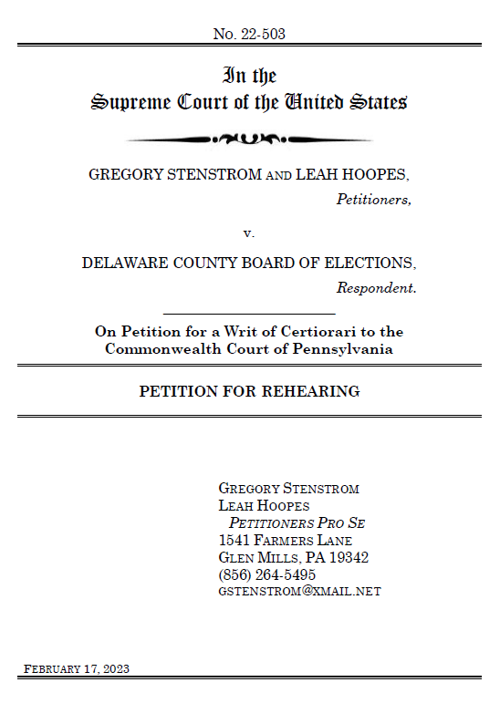
"Plaintiffs Stenstrom and Hoopes were denied Writ of Certiorari without opinion on January 23rd, 2023 (SCOTUS Docket 22-503). Plaintiffs request reconsideration based on fungible “justiciability” and denial of due process, and denial of equal protection under the law. Recent developments regarding Plaintiffs’ vigorous efforts to preserve evidence for the subject case, that were not available at the time of filing the original Writ of Certiorari, are also included for consideration."
"A Court, any Court, that allows fungible “justiciability,” and permits the wanton violations of law by government officials, and their open rebuke of the Court’s orders and authority, has no authority."

Slide 6
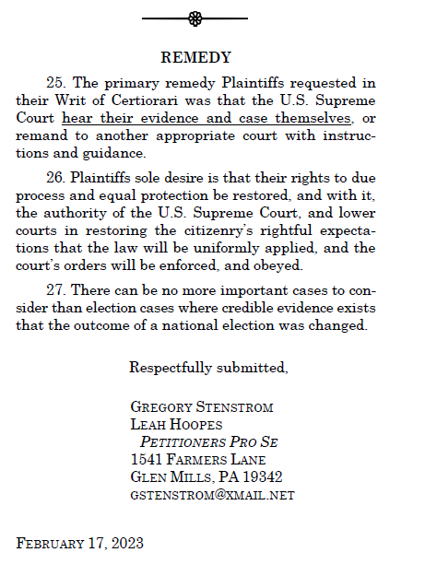

Slide 7
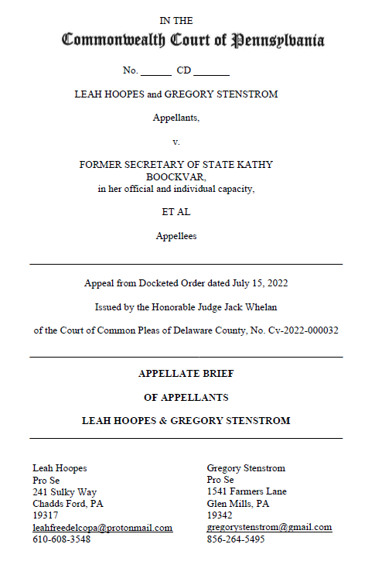
Commonwealth Court of Harrisburg Deleted, Struck from Docket, and Quashed Spoliation Case
Submitted entire stricken case to SCOTUS in Reconsideration to ensure record remains of corruption.
Submitted in Reconsiderations in both Commonwealth and Common Pleas.
Not going to “go away.”
Will be used in future.

Slide 8
Moton, Hoopes and Stenstrom v Delaware County, BOE, et al CV-2022-000032
Delaware County Court of Common Pleas (again…)
Wanton Destruction of Evidence and Refusal to Fulfill RTK (FOIA)
Corroborates Evidence already submitted, and is Supplemental and Complementary
SPOLIATION, VIDEOS OF DESTRUCTION OF EVIDENCE – 98 Exhibits
Judge Whelan has done everything possible to quash
Motion to Strike Opinion of Judge Whelan for Document and Docket tampering submitted 06 Dec 2022. BLUNTLY ACCUSED HIM OF CRIMINAL MALFEASANCE
Commonwealth Court of PA case CD 876 2022 was scheduled.
Jan 31 2023, Commonwealth administratively Quashed and Judge Whelan Dismissed
Request for Reconsideration Submitted 11Feb, rejected by OJS, not docketed and no notification, demanded it be backdated and resubmitted 12Feb (timely).
Submitted with SCOTUS reconsideration in Appendices so it cannot be stricken from record - JUSTICIABILITY

Slide 9
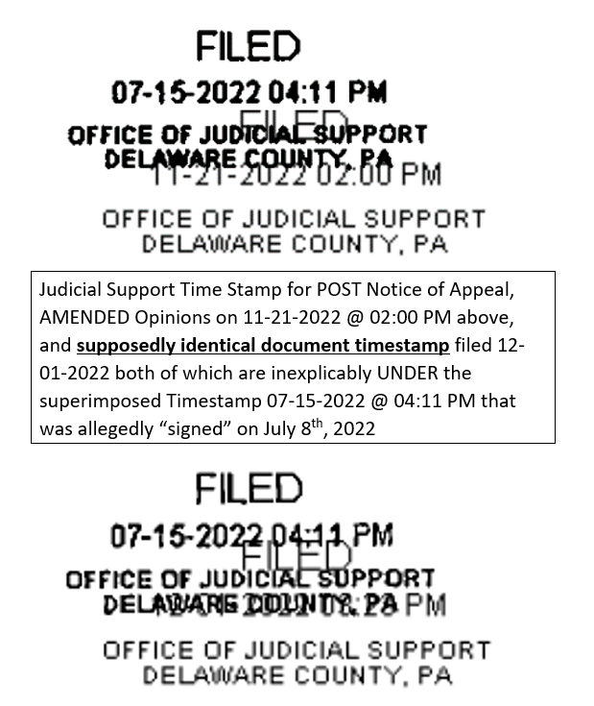
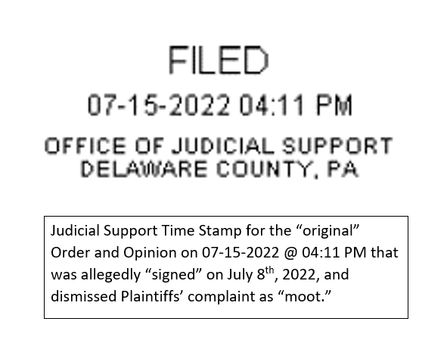

Slide 10
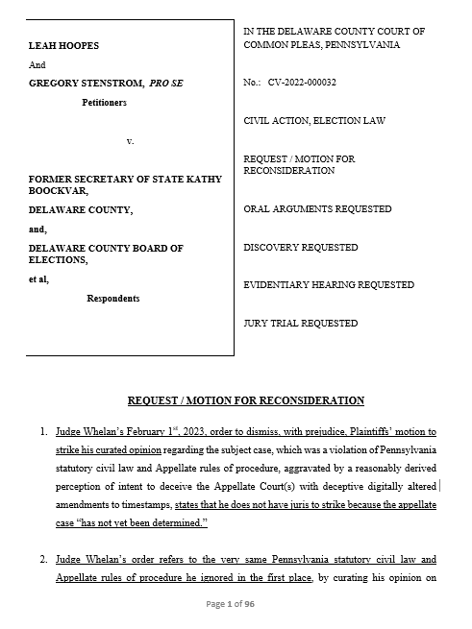
Judge Whelan’s February 1st, 2023, order to dismiss, with prejudice, Plaintiffs’ motion to strike his curated opinion regarding the subject case, which was a violation of Pennsylvania statutory civil law and Appellate rules of procedure, aggravated by a reasonably derived perception of intent to deceive the Appellate Court(s) with deceptive digitally altered amendments to timestamps, states that he does not have juris to strike because the appellate case “has not yet been determined.”
Judge Whelan’s order refers to the very same Pennsylvania statutory civil law and Appellate rules of procedure he ignored in the first place, by curating his opinion on December 1st, 2022, five months after Plaintiffs’ notice of appeal, and an incongruence of convenience in choosing when to follow, or not follow, cited laws and rules.

Slide 11
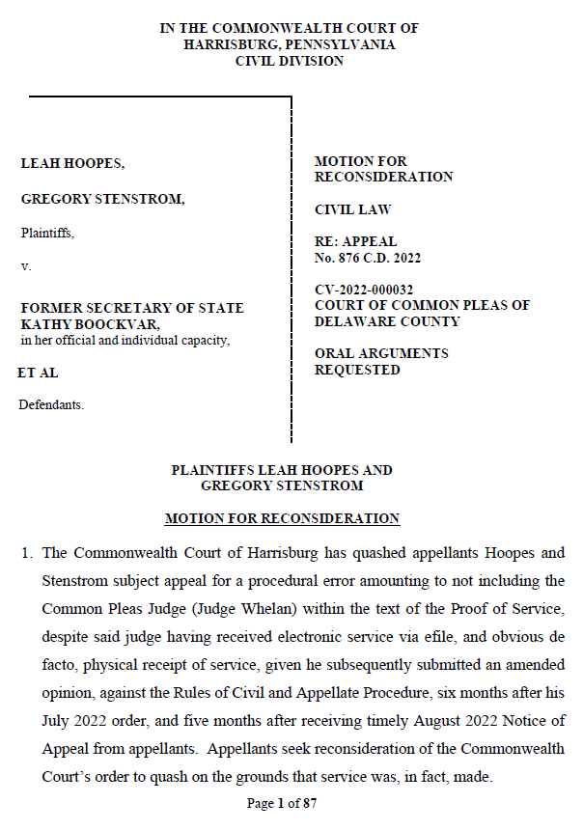

Slide 12
Missino, Hoopes and Stenstrom v Delaware County, BOE, et al CV-2022-008091
Delaware County Court of Common Pleas (again…)
Litigative Stakes in Ground
Injunctions
3 Hearings – Injunctions
Underlying Complaint still alive for Breach of Fiduciary Duty
Objections exchanged
Litigation Hold submitted to include retaining final Return Board Report
Amended to add Defendants (in official capacity)
Judge still not assigned yet – Judge Dozer trying to quash case
Delco County Council and Solicitor Martin (Defendants) passed ordinance to stop Return Board Reports – PA Title 18 criminal misdemeanor (2nd degree)

Slide 13
Patriot.Online
https://www.patriot.online
https://www.patriot.online/election_resources.html
https://parallelelection.com
DONATE

